Slide 1

Naming Convention 9 Basic Rules for any Piece of Code

Slide 2


Introduction
“The ratio of time spent reading (code) versus writing is well over 10 to 1 … (therefore) making it easy to read makes it easier to write.” — Robert C. Martin
The naming convention is a very contentious topic. Everyone has their own style when it comes to naming variables, functions, classes, and even documentation.
There is no single or standard way to name your code parts.

Slide 3
Definition
“Naming convention is a set of rules for choosing the character sequence to be used for identifiers which denote variables, types, functions, and other entities in source code and documentation” — Wikipedia

Slide 4

The Challenge
“The hardest thing about choosing good names is that it requires good descriptive skills and a shared cultural background. This is a teaching issue rather than a technical, business or management issue.”

Slide 5

We’re all different and from different backgrounds. One can describe a thing completely different for others. More than that, people from different cultures can describe the same things differently.
Selecting the proper name for a function or a variable requires experience and many hours of code reading. This challenge is not a technical or management challenge, it’s a skill that requires much practice.

Slide 6
Rule #1 Consistency
Pick One Word per Concept — Use the same concept across the codebase

Slide 7
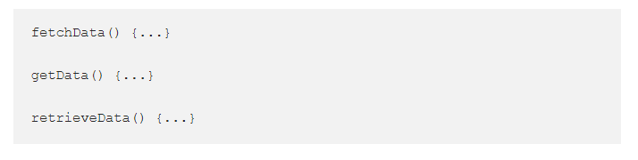
All 3 names of the above methods are the same and can be interpreted as the same operation. It doesn’t matter which one we actually pick, but it’s important that we’re consistent throughout the code. If we decide that fetch will request data remotely, we should stick with that convention for fetchPermissions and fetchUserDetails for instance.

Slide 8
Rule #2 Meaningful
Characters are cheap, confusion is expansive

Slide 9
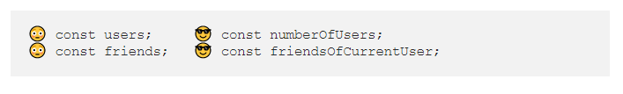
We write code with a 100% mindset of that feature or context. We forget that the next reader might come with a different mindset, so we should make sure we avoid ambiguity.
For instance, in function scope, we wrote users but we actually meant numberOfUsers, which can be misleading. Or if we wanted to create a variable with all the current user’s friends, we should name it friendsOfCurrentUserrather than friends.

Slide 10
Rule #3 Meaningful Distinctions
Use the same word for the same purpose
Two different things in the same scope? You might be tempted to change one name 😡
What is these functions’ return? 😕

Slide 11
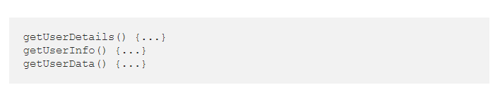
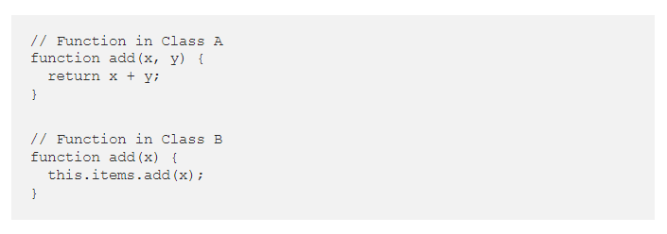
What’s the difference between details/info/data anyway?!
If we have 2 definitions for “not that different” object/class/variable we should consider aggregating its content differently. Or changing one of the names dramatically.
Another use-case:
In class A, the add(x, y) function adding 2 numbers and in class B add(x) is insert element to the collection. Both functions' names are correct, but without deep-dive to their implementations, you won’t be able to understand and use them.
A better name will be:
add(x, y) -> addNumbers(x, y)
add(x) -> insertElement(x)

Slide 12
Rule #4 Avoid Encodings
Avoid unnecessary encodings of data-types along with the variable name

Slide 13
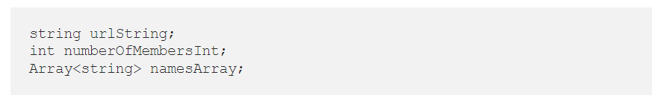
It might look good and be a useful practice, but in order to scale, this ambiguity will be annoying and hard to maintain.
The name should be a higher abstraction level of the implementation details of the actual variable type.

Slide 14
Rule #5 Use Pronounceable Names
Nobody wants a tongue twister or a non-searchable words

Slide 15
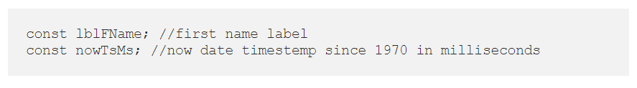
These kinds of variables names are hard to pronounce and no one will be able to remember them, aside from the writer themself.
Moreover, our code should be able to be searchable. When the project becomes bigger and bigger we will search more and more. Better naming make scaling easier.

Slide 16
Don’t Be Offensive/Cute
Rule #6
Nobody wants a tongue twister or a non-searchable words

Slide 17
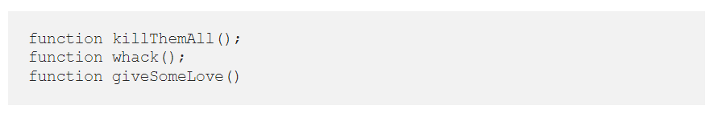
Some projects are open-source, some are cross-cultural. The name you pick for your function will be read by a variety of people. The same thing can be interpreted differently between different people.
Naming convention should be generic, and as professional as possible, and should not include any cultural slang.

Slide 18
Be Positive
Rule #7
shouldNotShowIfDisabledIsFalse ✌️

Slide 19
isDisabled should become isEnabled
isUndefined should become isDefined
shouldNotShowScreen should become shouldShowScreen
avoidBroadcast should become doBroadcast
broadcastNotArrived() should become broadcastArrived({})
As humans, we have a better understanding of the positive approach (besides the new-age approach 😎) so we should use them in the names we pick.

Slide 20
Helper to the Manager with some Utils 🙄
Rule #8

Slide 21
NetworkHelper
RequestManager
HttpUtils
These names above are just a way to ignore the challenges of select a descriptive name to that piece of code. No one really understands what has inside these files (or classes) or what does it do.
We better avoid these names, by avoiding that we’ll arrange our code better and won’t give life to these god objects.

Slide 22
Awareness 🤖
Rule #9
Characters are cheap, confusion is expansive ✌️

Slide 23
A few general bullets to keep in mind while we coding:
We are NOT the only ones who read our code
Our mood is NOT related to the code we’re writing
Humans read our code, not computers
Read your code after you write it

